Slide 1
Security Testing through Automated Software Tests
Stephen de Vries,
Principal Consultant, Corsaire
stephen.de.vries@corsaire.com

Slide 2
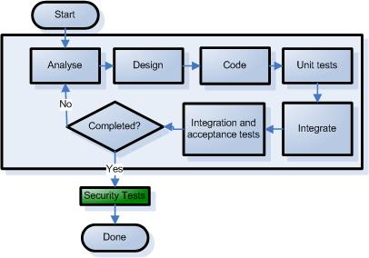
Typical Iterative development life cycle
  Sub bullet
Correcting issues is costly
The people who understand the code best, don’t perform the security tests
No buy-in from developers into the security process
Notes:
A common thread in the OWASP discussions and I think something we would all agree on, is that to improve the security of software, security must be built into the SDLC.
When integrating the security into the SDLC it’s common to talk about putting security architecture reviews and code reviews into the process. But something which is not commonly considered is using the existing functional testing phases to perform security testing.
There is the perception that security testing can only be done by specially trained security ninjas.

Slide 3
Typical Iterative development life cycle
Notes:
Testing is already part of the development process, particularly the agile processes such as XP. But this testing is only focussed on meeting the functional requirements of the application - and not any security requirements.
Developers are very comfortable writing functional tests and there are a wealth of frameworks and tools to do this.
So instead of trying to shoe-horn security in at the end, we can get a significant benefit from integrating security into these existing test phases.

Slide 4
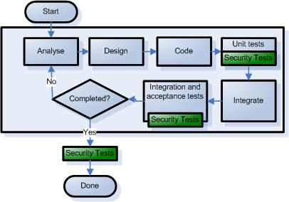
Typical Iterative development life cycle
Integrating Security Tests in the process:
A shorter security testing phase
More robust applications because testing is deep
Developer involvement in security

Slide 5
Outline
A taxonomy and description of testing types
An introduction to JUnit and examples of its use
Testing compliance to a security standard
Testing security in Unit Tests
Testing security in Integration Tests
Testing security in Acceptance Tests
Conclusion
Q & A

Slide 6

Use cases and Abuse cases
Use cases
  Expected behaviour
  Normal input
  Functional requirements
Abuse cases
  Unexpected behaviour
  By Malicious agents
  Derived from risk assessment
  Developers should think evil which leads to…
  Defensive programming
Notes:
…functional requirements, so the current practise is to write tests that verify use cases.
There are two ways that abuse cases can be defined. Firstly you’d want to capture all the big architectural issues during a risk assessment. This is not too uncommon to find in software projects already.
The second method is a more embedded approach, and that is that developers should think evil. Think about the ways the code can be subverted.
Security testing is primarily focussed on testing abuse cases.

Slide 7
Taxonomy of Automated Software Tests
Unit Tests
Integration Tests
Acceptance Tests
Notes:
What are automated software tests? They are tests written by developers to test their own code. They are widely adopted as a means of ensuring code quality. If you think about software projects that release nightly builds - this is only possible through automated software tests.
Lower level to high level
As you move from the unit through to acceptance tests we’re moving from a fine grained test that tests the individual methods of a class, through to integration tests that test the interaction between classes and finally on to the external api of the application which tests what the user final sees.

Slide 8
Taxonomy of Automated Software Tests
Unit Tests
  Operate at the method and class level
  High test coverage
  Test in isolation - stubs and mocks
  Executed the most frequently
  Written by developers
Notes:
…
Unit tests introduced a mini revolution in the way that software is developed because they made testing part of the coding process.

Slide 9
Taxonomy of Automated Software Tests
Integration Tests
  Integration between classes and modules
  Integration between tiers
  In-container tests or Mock objects
  Executed often, but not as often as unit tests
  Written by developers

Slide 10
Taxonomy of Automated Software Tests
Acceptance Tests
  Performed on the external API
  Low test coverage
  Executed the least frequently
  Performed by QA testers
Notes:
…

Slide 11
Introducing JUnit
“Never in the field of software development was so much owed by so many to so few lines of code.”
- Martin Fowler
Notes:
Junit is a java implementation of a unit testing framework and was one of the first of these frameworks to be developed.
The magic of Junit is not in the code, it’s in the process that it created where developers could write tests alongside the code.

Slide 12
Introducing JUnit
  Example: A single method from a shopping cart class
  public void addItem(Item item, boolean inStock) {
  CartItem cartItem = (CartItem) itemMap.get(item.getItemId());
  if (cartItem == null) {
  cartItem = new CartItem();
  cartItem.setItem(item);
  cartItem.setQuantity(0);
  cartItem.setInStock(inStock);
  itemMap.put(item.getItemId(), cartItem);
  itemList.getSource().add(cartItem);
  }
  cartItem.incrementQuantity();
  }
Notes:
The best way to understand unit testing is to write one.

Slide 13
Introducing JUnit
Test that:
  a new cart has 0 items in it
  adding a single item results in that item being present in the cart
  adding a single item results in the cart having a total of 1 items in it
  adding two items results in both items being present in the cart
  adding two items results in the cart having a total of 2 items in it
  Test whether adding a null item results in an exception and nothing being set in the cart
Notes:
…this provides a nice clear and concise form of documentation of what the function is meant to do.

Slide 14
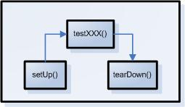
Introducing JUnit
public class CartTest extends TestCase {
public CartTest(String testName) {
super(testName);
}
protected void setUp() throws Exception {
//Code here will be executed before every testXXX method
}
protected void tearDown() throws Exception {
//Code here will be executed after every testXXX method
}
public void testNewCartHasZeroItems() {
// Test code goes here
}
public void testAddSingleItem() {
// Test code goes here
}
public void testAddTwoItems() {
// Test code goes here
}
public void testAddNullItem() {
// Test code goes here
}
}
Notes:
Junit uses the following flow when executing tests.

Slide 15
Introducing JUnit
public void testAddTwoItems() {
Cart instance = new Cart();
boolean isInStock = true;
//First add an item
Item item = new Item();
item.setItemId("item01");
instance.addItem(item, isInStock);
//Test adding a second item
Item item2 = new Item();
item2.setItemId("item02");
instance.addItem(item2, isInStock);
//Check whether item01 is in the cart
boolean result = instance.containsItemId("item01");
assertTrue("First item is in cart", result);
//Check whether item02 is in the cart
result = instance.containsItemId("item02");
assertTrue("Second item is in cart", result);
//Check that there are 2 items in the cart
assertEquals("2 items in cart", instance.getNumberOfItems(), 2);
}
USE CASE TEst
Notes:
…

Slide 16
Introducing JUnit
public void testAddNullItem() {
Cart instance = new Cart();
boolean isInStock = true;
try {
instance.addItem(null, isInStock);
fail("Adding a null item did not throw an exception");
} catch (RuntimeException expected) {
assertTrue("null Item caught",true);
assertEquals("Null not in cart", instance.getNumberOfItems(), 0);
}
}
ABUSE CASE TEST
Notes:
…
Is a use case
This aides debugging tremendously.
Prevents regressions.
Allows us to refactor without fear.

Slide 17
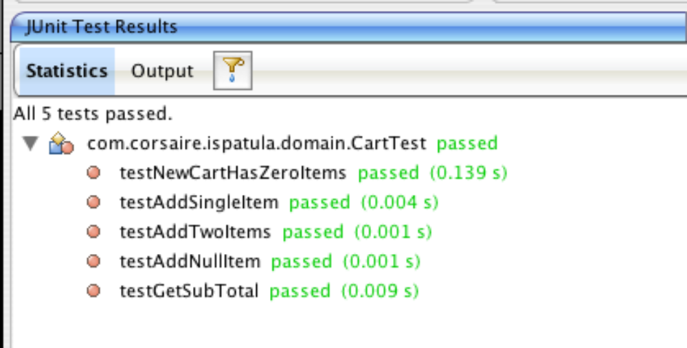
Introducing JUnit
Using JUnit
  Supported in all Java IDE’s
  Ant and Maven support
  Part of the code-debug cycle

Slide 18
Introducing JUnit
Other Unit testing frameworks
  Java – JUnit, (www.junit.org), TestNG (http://beust.com/testng/), JTiger (www.jtiger.org)
  Microsoft .NET – NUnit (www.nunit.org), .NETUnit (http://sourceforge.net/projects/dotnetunit/), ASPUnit (http://aspunit.sourceforge.net/), CSUnit (www.csunit.org) and MS Visual Studio Team Edition and many more.
  PHP – PHPUnit (http://pear.php.net/package/PHPUnit), SimpleTest (www.simpletest.org)
  Coldfusion – CFUnit (http://cfunit.sf.net), cfcUnit (www.cfcunit.org)
  Perl – PerlUnit (http://perlunit.sf.net), Test::More (included with Perl)
  Python – PyUnit (http://pyunit.sf.net), doctest (included in standard library)
  Ruby – Test::Unit (included in the standard library)
  C – CUnit (http://cunit.sf.net), check (http://check.sf.net)
  C++ – CPPUnit (http://cppunit.sf.net), cxxtest (http://cxxtest.sf.net)

Slide 19
Web Application Security Standards
What is a Web Application Security Standard?
  Derived from an organisation’s Security Policy
  Similar to an Operating System Build Standard
  Defines how the application should behave from a security point of view
  Should include functional and non-functional security aspects
Notes:
When talking about security testing it’s useful to do so in the framework of an application security standard.
…

Slide 20
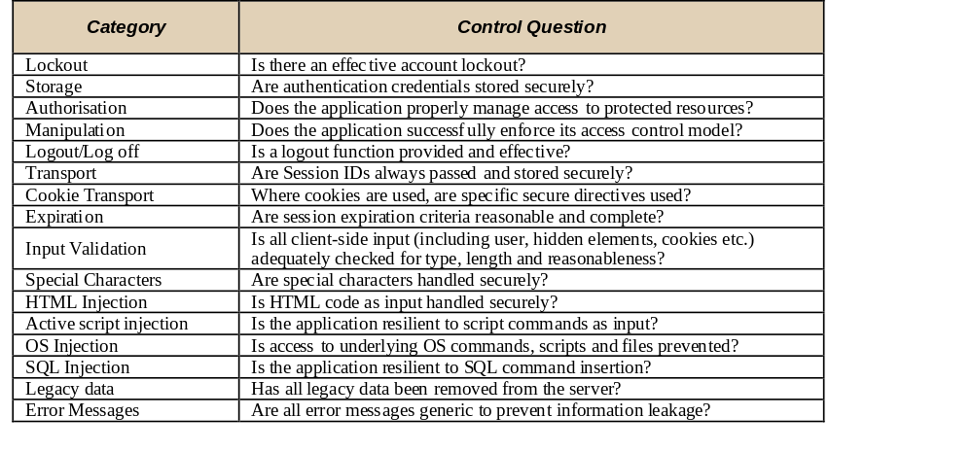
Web Application Security Standards
Example:

Slide 21
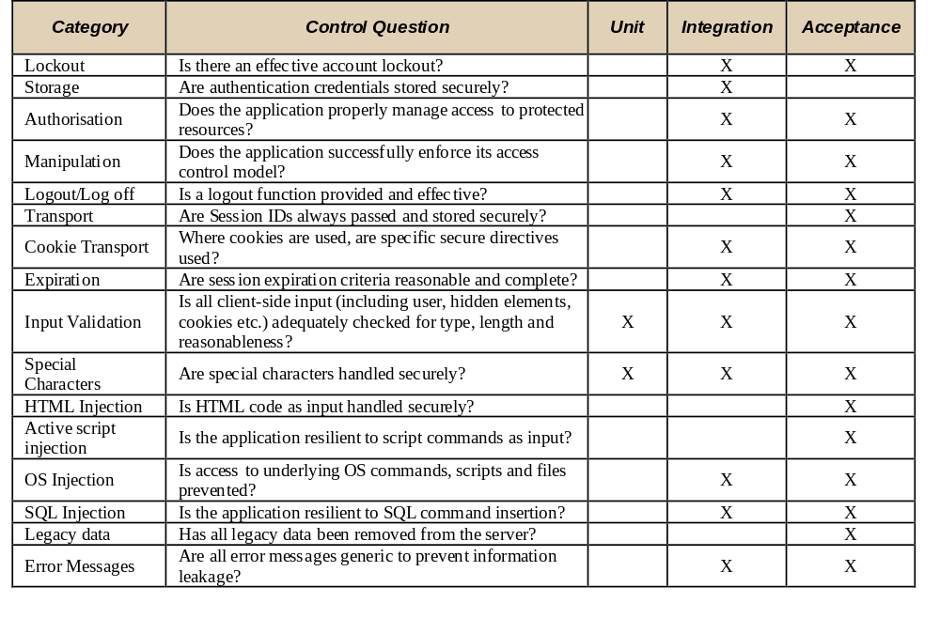
Web Application Security Standard
Notes:
…
Looking at a more complete security standard, a pattern begins to emerge and it becomes clear that the majority of tests can be performed in integration and acceptance tests and fewer in unit tests.
In the next sections we will look at implementing security tests in each of these testing layers.

Slide 22
Testing Security in Unit Tests
Test Valid Input
public void testValidPhoneNumbers() {
//Test valid input
String number = "232321";
acc.setPhone(number);
validator.validate(acc, errors);
assertFalse(number+" caused a validation error.",
errors.hasFieldErrors("phone"));
number = "+23 232321";
acc.setPhone(number);
validator.validate(acc, errors);
assertFalse(number+" caused a validation error.",
errors.hasFieldErrors("phone"));
number = "(44) 32321";
acc.setPhone(number);
validator.validate(acc, errors);
assertFalse(number+" caused a validation error.",
errors.hasFieldErrors("phone"));
//etc…
}
Notes:
Is my input validation function working as it should?

Slide 23
Testing Security in Unit Tests
Test Invalid Input:
public void testIllegalCharactersInPhoneNumber() {
String number = "+(23)';[]232 - 321";
acc.setPhone(number);
validator.validate(acc, errors);
assertTrue(number+" did not cause a validation error.",
errors.hasFieldErrors("phone"));
}
public void testAlphabeticInPhoneNumber() {
String number = "12a12121";
acc.setPhone(number);
validator.validate(acc, errors);
assertTrue(number+" did not cause a validation error.",
errors.hasFieldErrors("phone"));
}

Slide 24
Testing Security in Unit Tests
Advantages of testing at this layer
  Tests are run very frequently - issues are identified quickly
  Most granular form of test - high test coverage
Disadvantages
  Not many security vulnerabilities can be tested at this layer

Slide 25
Testing Security in Integration Tests
In-container testing
  Realistic and complete
  Requires specific tools
  Overhead in starting container
Mock Objects
  Server API is faked
  Generic solution
  No container overhead

Slide 26
Testing Security in Integration Tests
In-container testing with Apache Cactus
  Popular tool for testing J2EE applications
  Can test EJB and Web tiers
  Plugin’s for Jetty, Eclipse, Ant and Maven

Slide 27
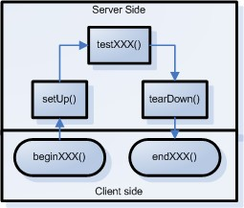
Testing Security in Integration Tests
Lifecycle of a single cactus test
beginXXX() - setup the client side
setUp() - common server side code
testXXX() - server side test
tearDown() - common server side code
endXXX() - client side tests
Notes:
Apache cactus test has two components, a client side and a server side component.

Slide 28
Testing Security in Integration Tests
public class TestAccessControl extends ServletTestCase {
public void beginUnprivilegedUserAccessControl(WebRequest
theRequest) {
theRequest.setAuthentication(new
BasicAuthentication("user", "password"));
}
public void testUnprivilegedUserAccessControl() throws
IOException, javax.servlet.ServletException {
    AdminServlet admin = new AdminServlet();
    admin.doGet(request, response);
}
public void endUnprivilegedUserAccessControl(WebResponse
theResponse) throws IOException {
    assertTrue("Normal users must not be able to access /admin", theResponse.getStatusCode() == 401)
}
}
Notes:
Consider a web app that uses basic auth to prevent access to the admin servlet. Where this access control is implemented by the application server. We would like to test that a normal user does not have access to the Admin servlet.
…
This is a very powerful method of running virtually any test against the application: Create a request, execute the servlet and evaluate the response.

Slide 29
Testing Security in Integration Tests
Advantages of testing at this layer
  Can test in the application server
  Many security vulnerabilities can be tested, e.g.: Injection, Authentication flaws and Authorisation flaws.
Disadvantages
  Not executed as often as unit tests
  Overhead of starting an application server
  Some vulnerabilities may not be easily testable, e.g.: XSS, URL filtering performed by a web server or application firewall.

Slide 30
Security Testing in Acceptance Tests
Tests the external API
Language agnostic
2 types of tools:
  Include their own HTTP client and HTML parser, e.g.: HTTPUnit, jWebUnit, HtmlUnit, Canoo Webtest
  Drive a browser instance, e.g.: Selenium, WATIR, Watij
Notes:
…
The first type have the advantage that you can perform low level HTTP and SSL tests if you wanted to, but their achilles heel is poor JavaScript support.
The second group provide a very accurate view of the application because they drive a real browser, but on the downside it’s not that easy to do low level protocol tests.

Slide 31
Security Testing in Acceptance Tests
Example: Testing HTML injection with jWebUnit
public class XSSinSearchFieldTest extends WebTestCase {
public void setUp() throws Exception {
getTestContext().setBaseUrl("http://example.corsaire.com/ispatula/");
}
public void testHtmlInjection() throws Exception {
beginAt("/index.html");
assertLinkPresentWithText("Enter the Store");
clickLinkWithText("Enter the Store");
assertFormPresent("searchForm");
setFormElement("query",
"<a id=\"injection\" href=\"http://www.google.com>Injection</a>");
submit();
assertLinkNotPresent("injection");
}
public XSSinSearchFieldTest(String name) {
super(name);
}
}
Notes:
Think of jWebUnit as a scripted browser. All methods are called on the current window and it’s really quite logical.
Consider a search field in an application.

Slide 32
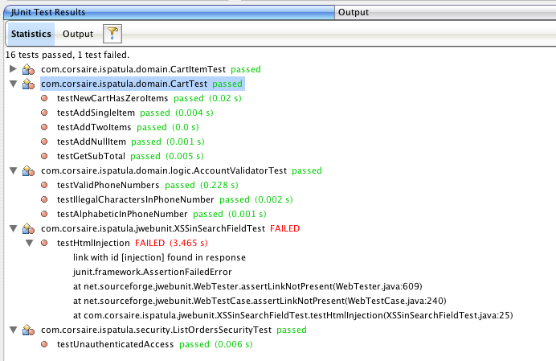
Security Testing in Acceptance Tests
Notes:
Because jwebunit is just an extension of junit it can be run in an ide.

Slide 33
Security Testing in Acceptance Tests
Example: Testing SQL injection with WATIR
class SQL_Injection_Test < Test::Unit::TestCase
include Watir
def test_SQL_Blind_Injection_in_Login()
$ie.goto('http://localhost:8080/ispatula')
$ie.link(:url, /signonForm.do/).click
$ie.text_field(:name, 'username').set('corsaire1\' OR 1=1--')
$ie.form(:action, "/ispatula/shop/signon.do").submit
assert($ie.contains_text('Signon failed'));
end
# Snip setup code
end
Notes:
Watir is a testing framework written ruby that drives an instance of internet explorer.
This test is going to check for SQL injection in the login form.
…

Slide 34
Security Testing in Acceptance Tests
Example: Testing XSS with WATIR
def test_XSS_In_Search
$ie.goto('http://example.corsaire.com/ispatula/shop/index.do')
$ie.text_field(:name, 'query').set('<script> window.open("http://example.corsaire.com/ispatula/help.html")</script>')
$ie.form(:action, /Search.do/).submit
assert_raises(Watir::Exception::NoMatchingWindowFoundException,
"Search field is susceptible to XSS") {
ie2 = Watir::IE.attach(:url,
"http://example.corsaire.com/ispatula/help.html")
}
end
Notes:
Consider an app that’s vulnerable to XSS in the search field.
…
So acceptance testing tools can be used to demonstrate every vulnerability found in an external pentest of a web app.

Slide 35
Security Testing in Acceptance Tests
Advantages of testing at this layer
  Full testing of external API
  Security consultants can use tools to script vulnerabilities
    Documents vulnerabilities
    Easy retesting
Disadvantages
  Low test coverage
  Developers aren’t involved in testing
Notes:
Wouldn’t it great if you commissioned a security assessment from a company, and at the end of it they handed you, not only a report, but also a set of automated tests that you could use to confirm the vulnerabilities?

Slide 36
Conclusions
Existing testing tools and techniques can be used for security testing in the development lifecycle
Developer training in security is a good investment!
Security issues are identified early
Code is subject to deep testing
Compliance with a Web App Security Standard can be demonstrated

